Slide 1
Face Aging
with Generative Adversarial Network
Machine Learning in Applications
Politecnico di Torino
Mattia Dutto, Julian Neubert, Simone Alberto Peirone

Slide 2
Table of contents
the “face filter” problem, autoencoder, GANs (4min) [Mattia]
Celeba: introduction, some images, attributes
correlation plot e introduction to the problem of bias + is not a good dataset
GAN (3min)
CycleGAN (take cycle gan scheme image from first page of the paper)
results from cycleGAN vs different num. of epochs
AE-StyleGAN (5min) + gif from 35k to 75k iterations [Julian]
FID has a measure, how it’s computed.
Ablation study
Mix styles (2 min)
Cycle-StyleGAN (5/7min) [Simone]
block scheme of the network -> from AE-StyleGAN to EMA passing through the training structure
Image results ( gif + table ) + fid
Conclusions (1 min)
Future work (1 min)

Slide 3
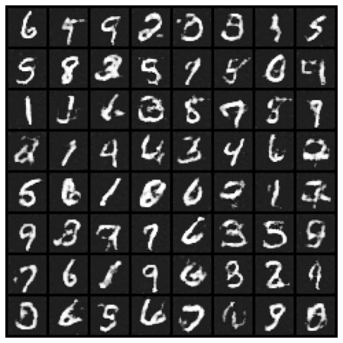
A little background
MNIST-like digits generated using a regular GAN after 5 training epochs

Slide 4



A little background…
Instagram
2010
Snapchat
2011
FaceApp
2017
Notes:
The most popular apps that allow you to edit a picture. It doesn’t matter if is your dog, a landscape or you, you can apply a filter that take the spectator to another dimension. You can change the color, the exposition, you can apply transformations at the point that you can fake your age. We try to reproduce this last aspect.

Slide 5
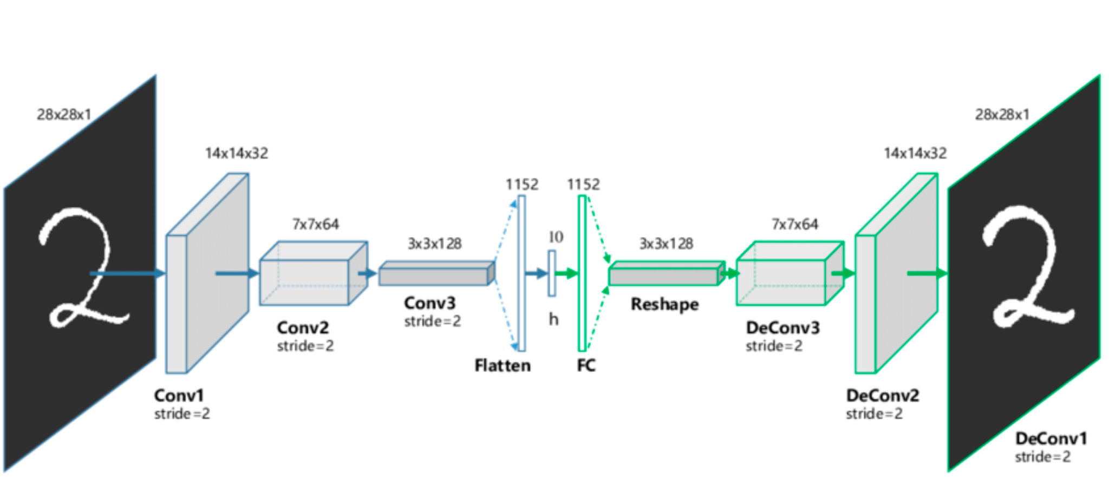
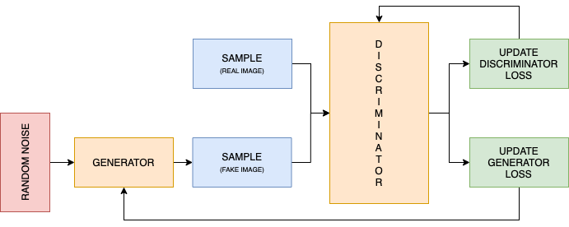
A little background
Problems:
Different images
Architecture
Solutions:
Auto-encoders
GAN
Notes:
In the real world.
We have the trouble of different images everybody is different we have to find a way to uniform this and allow the network to train in a good way. We can make a mean, but with not a lot of feature it will meaninfulles
Architecture what we can use?
Auto-encoder they look perfect especially if we can use the decoder part and mixing a little bit the new style. The decoder part of the auto-encoder will work as a generator, unfortunately AE doesn’t perm well with images like the one of CelebA due to the pixel-size.
GAN: Generative Adversarial Networks.

Slide 6
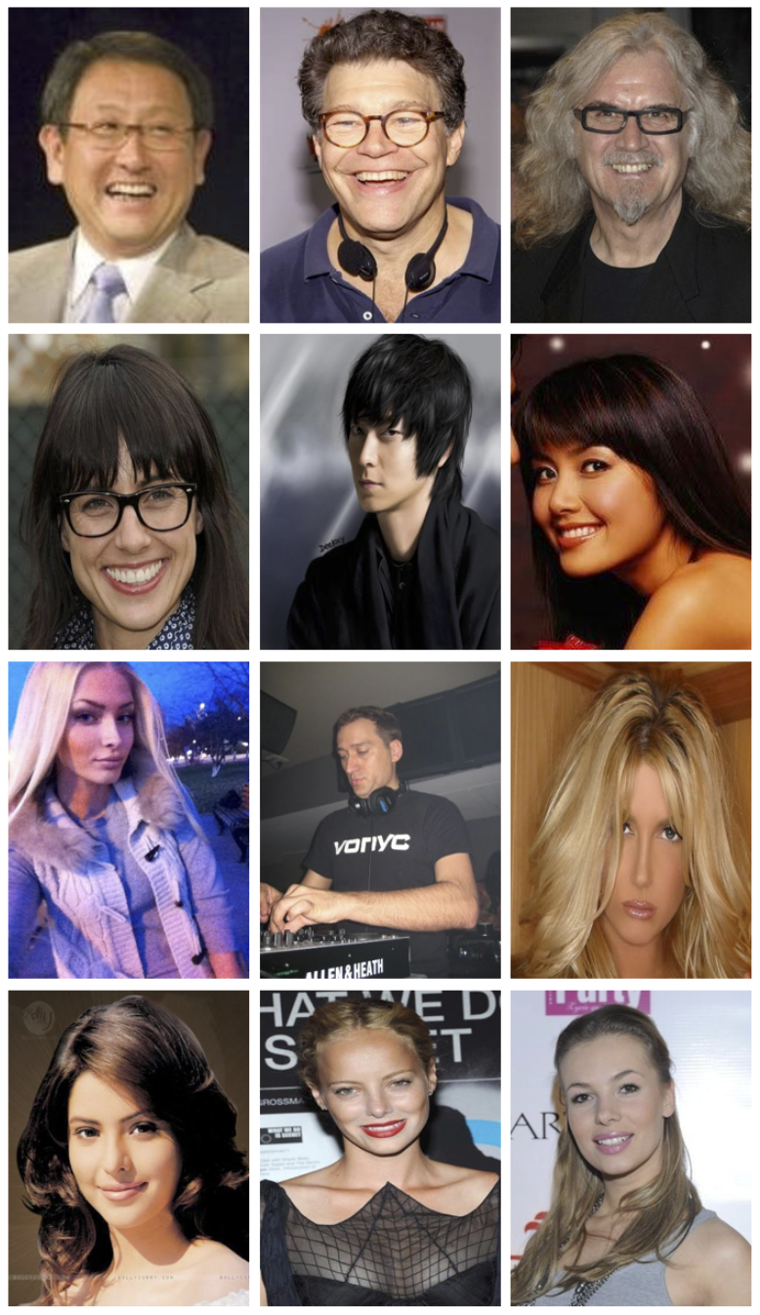
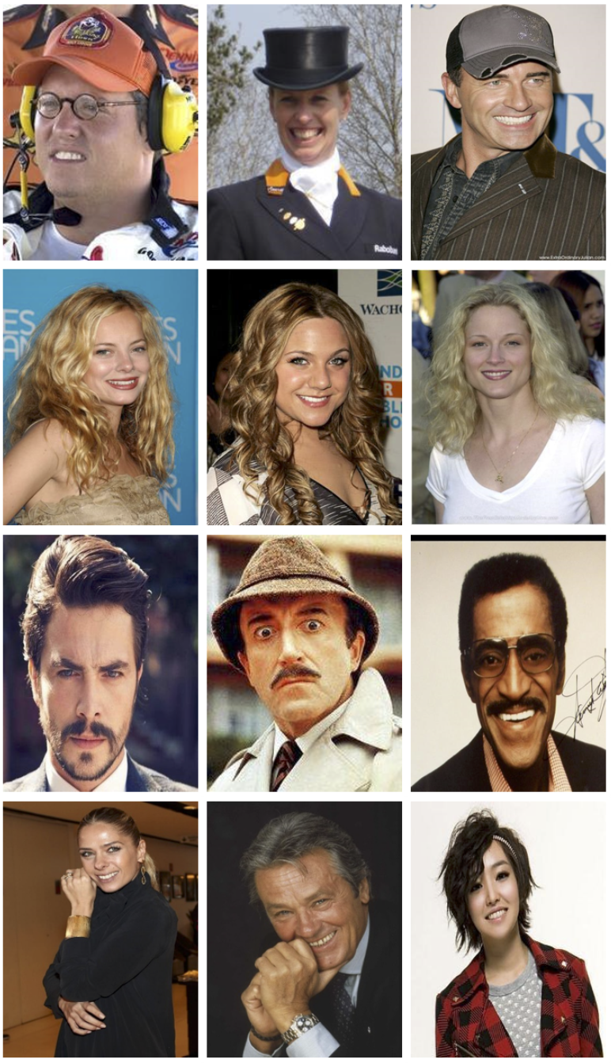
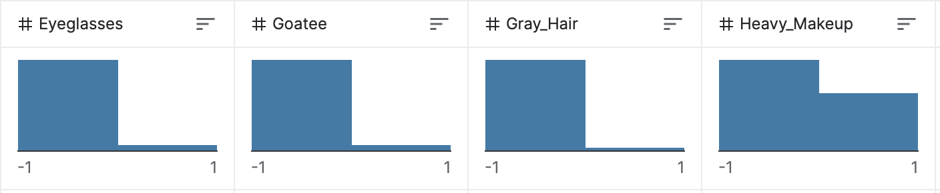
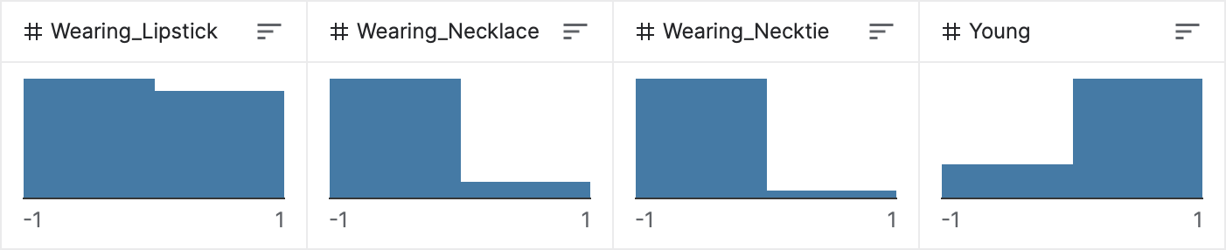
Dataset: CelebA
CelebA: CelebFaces Attributes Dataset
over 200k images
218 x 176px image
40 attributes
Attribute examples
Samples
Notes:
Here we can see a few details about the selected dataset, we can see a few sample and a few distribution on the attributes in particular we can see how the young attribute is distribute around ¾ of the image are young and the rest old.

Slide 7
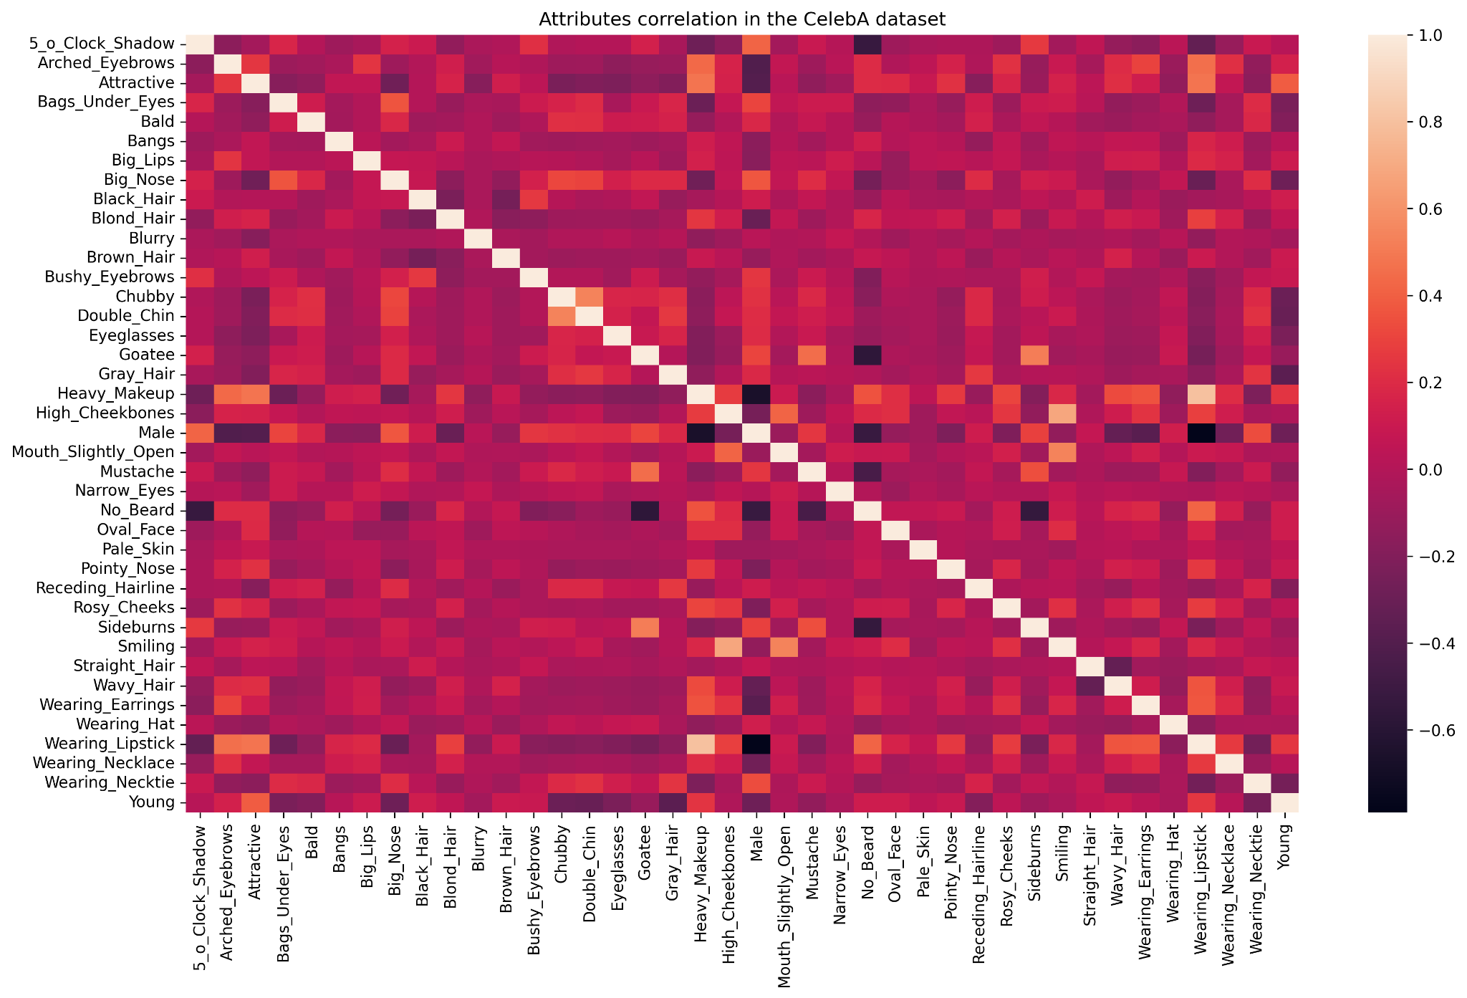
problems
Notes:
We have 3 main problem with this dataset:
as we can see from the correlation matrix we can see that the young attribute is positive correlated to attribute that are not correlated with young people. (here we can see the correlation matrix,
the dataset is biased to the white faces, has it was reported only the 20% is of black people.
the images are not good, the definition can be okey but the images are full of not necessary details other dataset are better. Also the pictures are not the best.

Slide 8
GAN: Generative Adversarial Network
GENERATOR
DISCRIMINATOR
NOISE
IMAGES

Slide 9
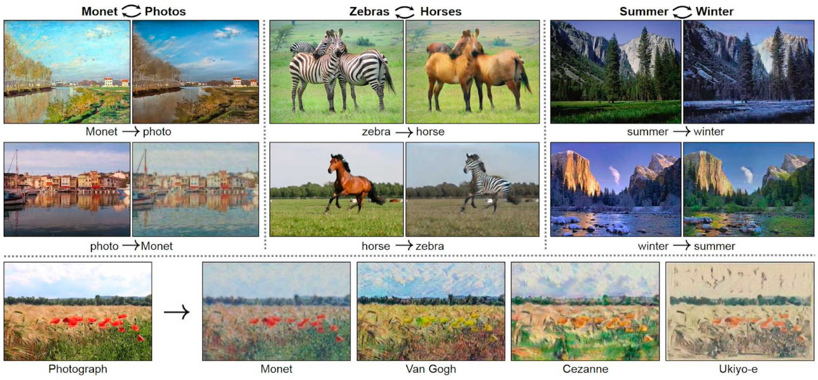
GAN: Generative Adversarial Network
Notes:
gans become very famous due to the usage in transfer learning. and here we can see some famous usage.

Slide 10
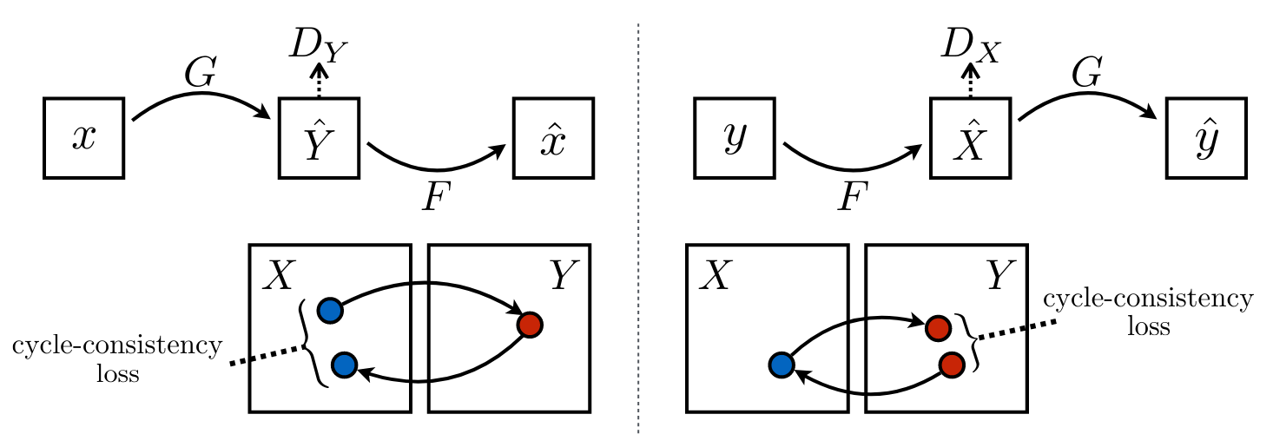
Cycle-GAN
Notes:
We were in search for a base network and looking at the literature CycleGAN can be okey for apply style transfer.
The approach of cycle gan is to combine 2 different gan networks that together can move from the original to the other domain (in out case young to old and vice-versa)
with the introduction of cycle we have the introduction of a new loss: the cycle-consistency that aim to allow the system to move to the other domain and came back to the original one, trying to reconstruct as much as possible the original image.
One problem of cycle-gan is the time of training: so for avoid this we move from the entire dataset around 160k are the one use for the training part to 1/10.

Slide 11
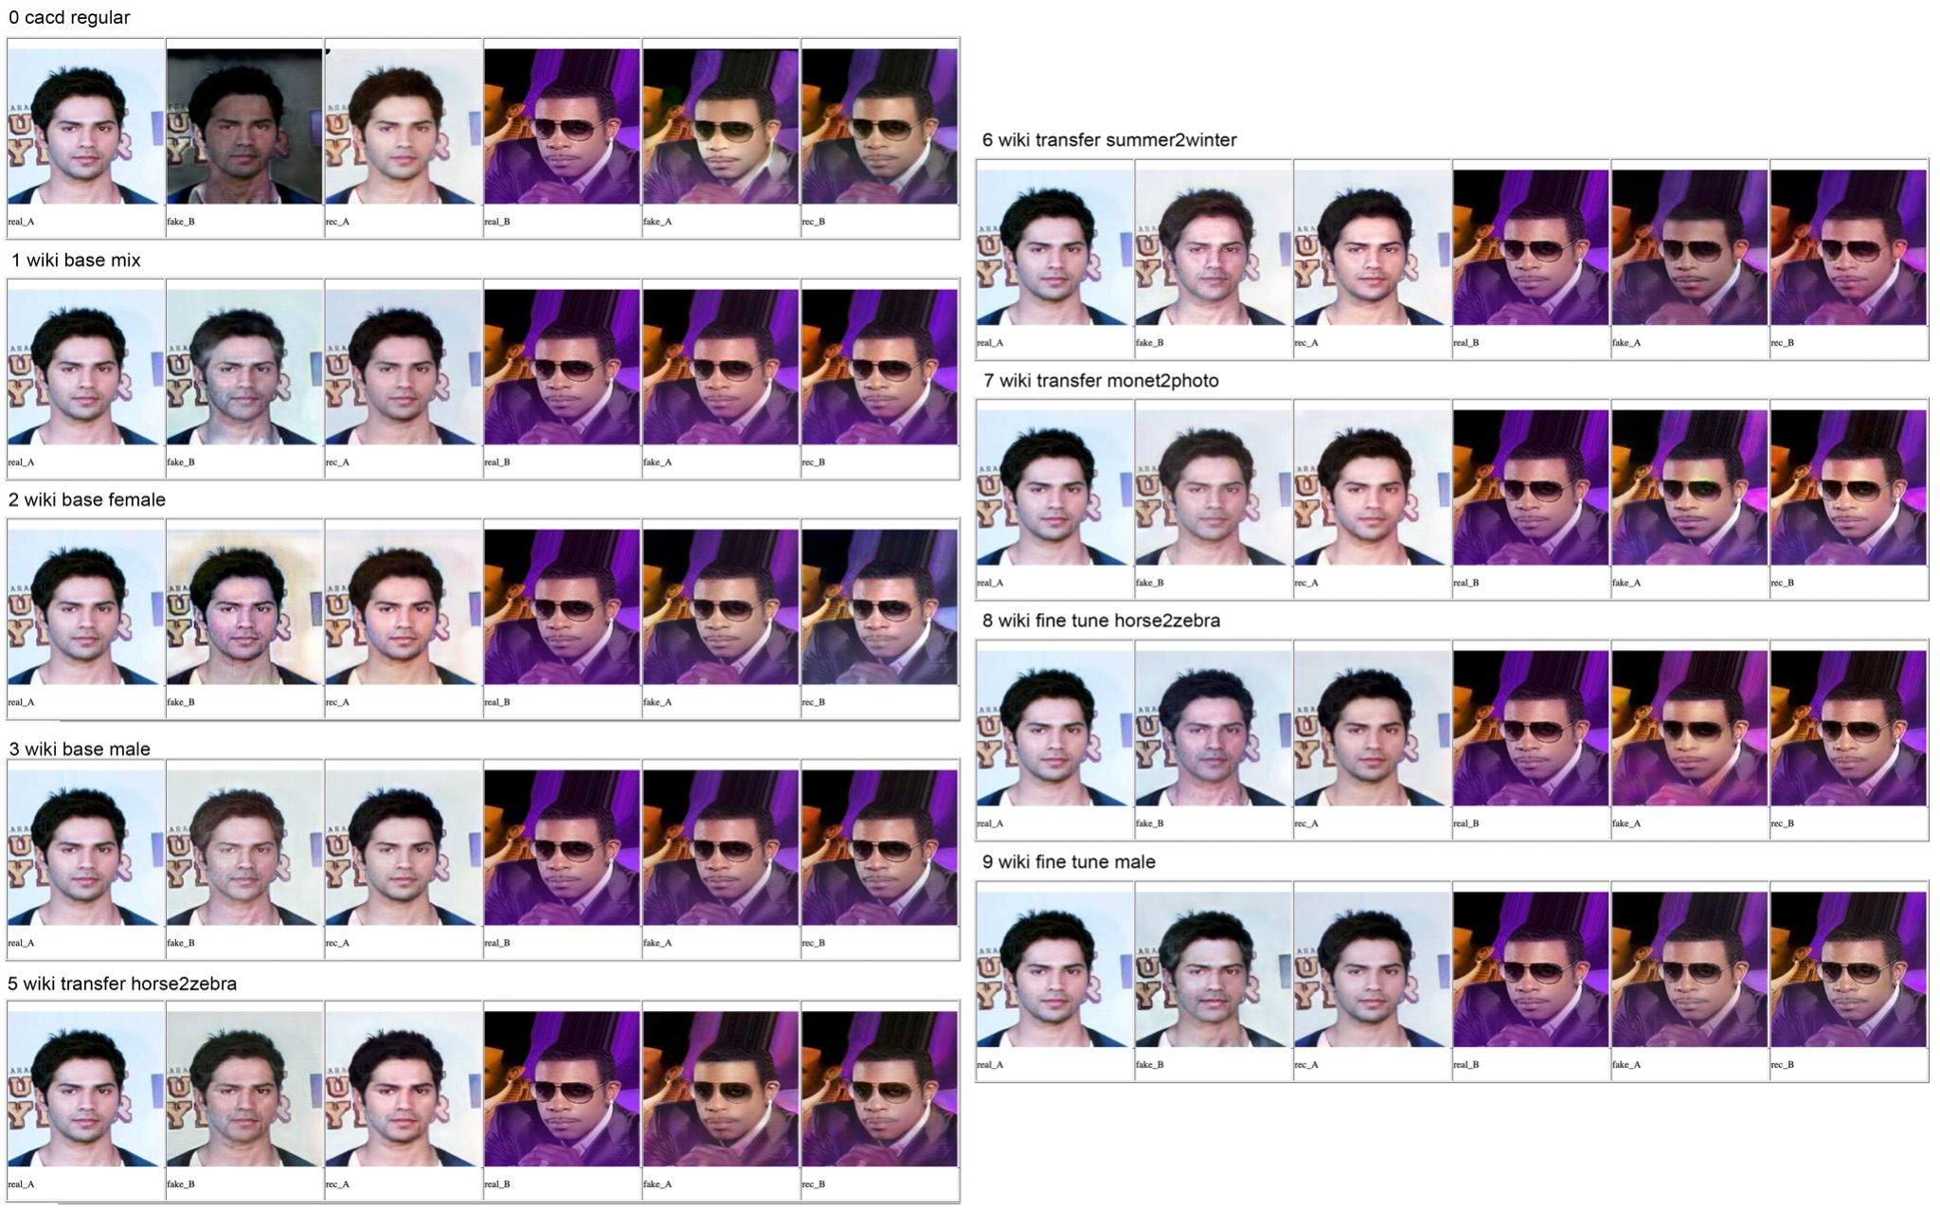
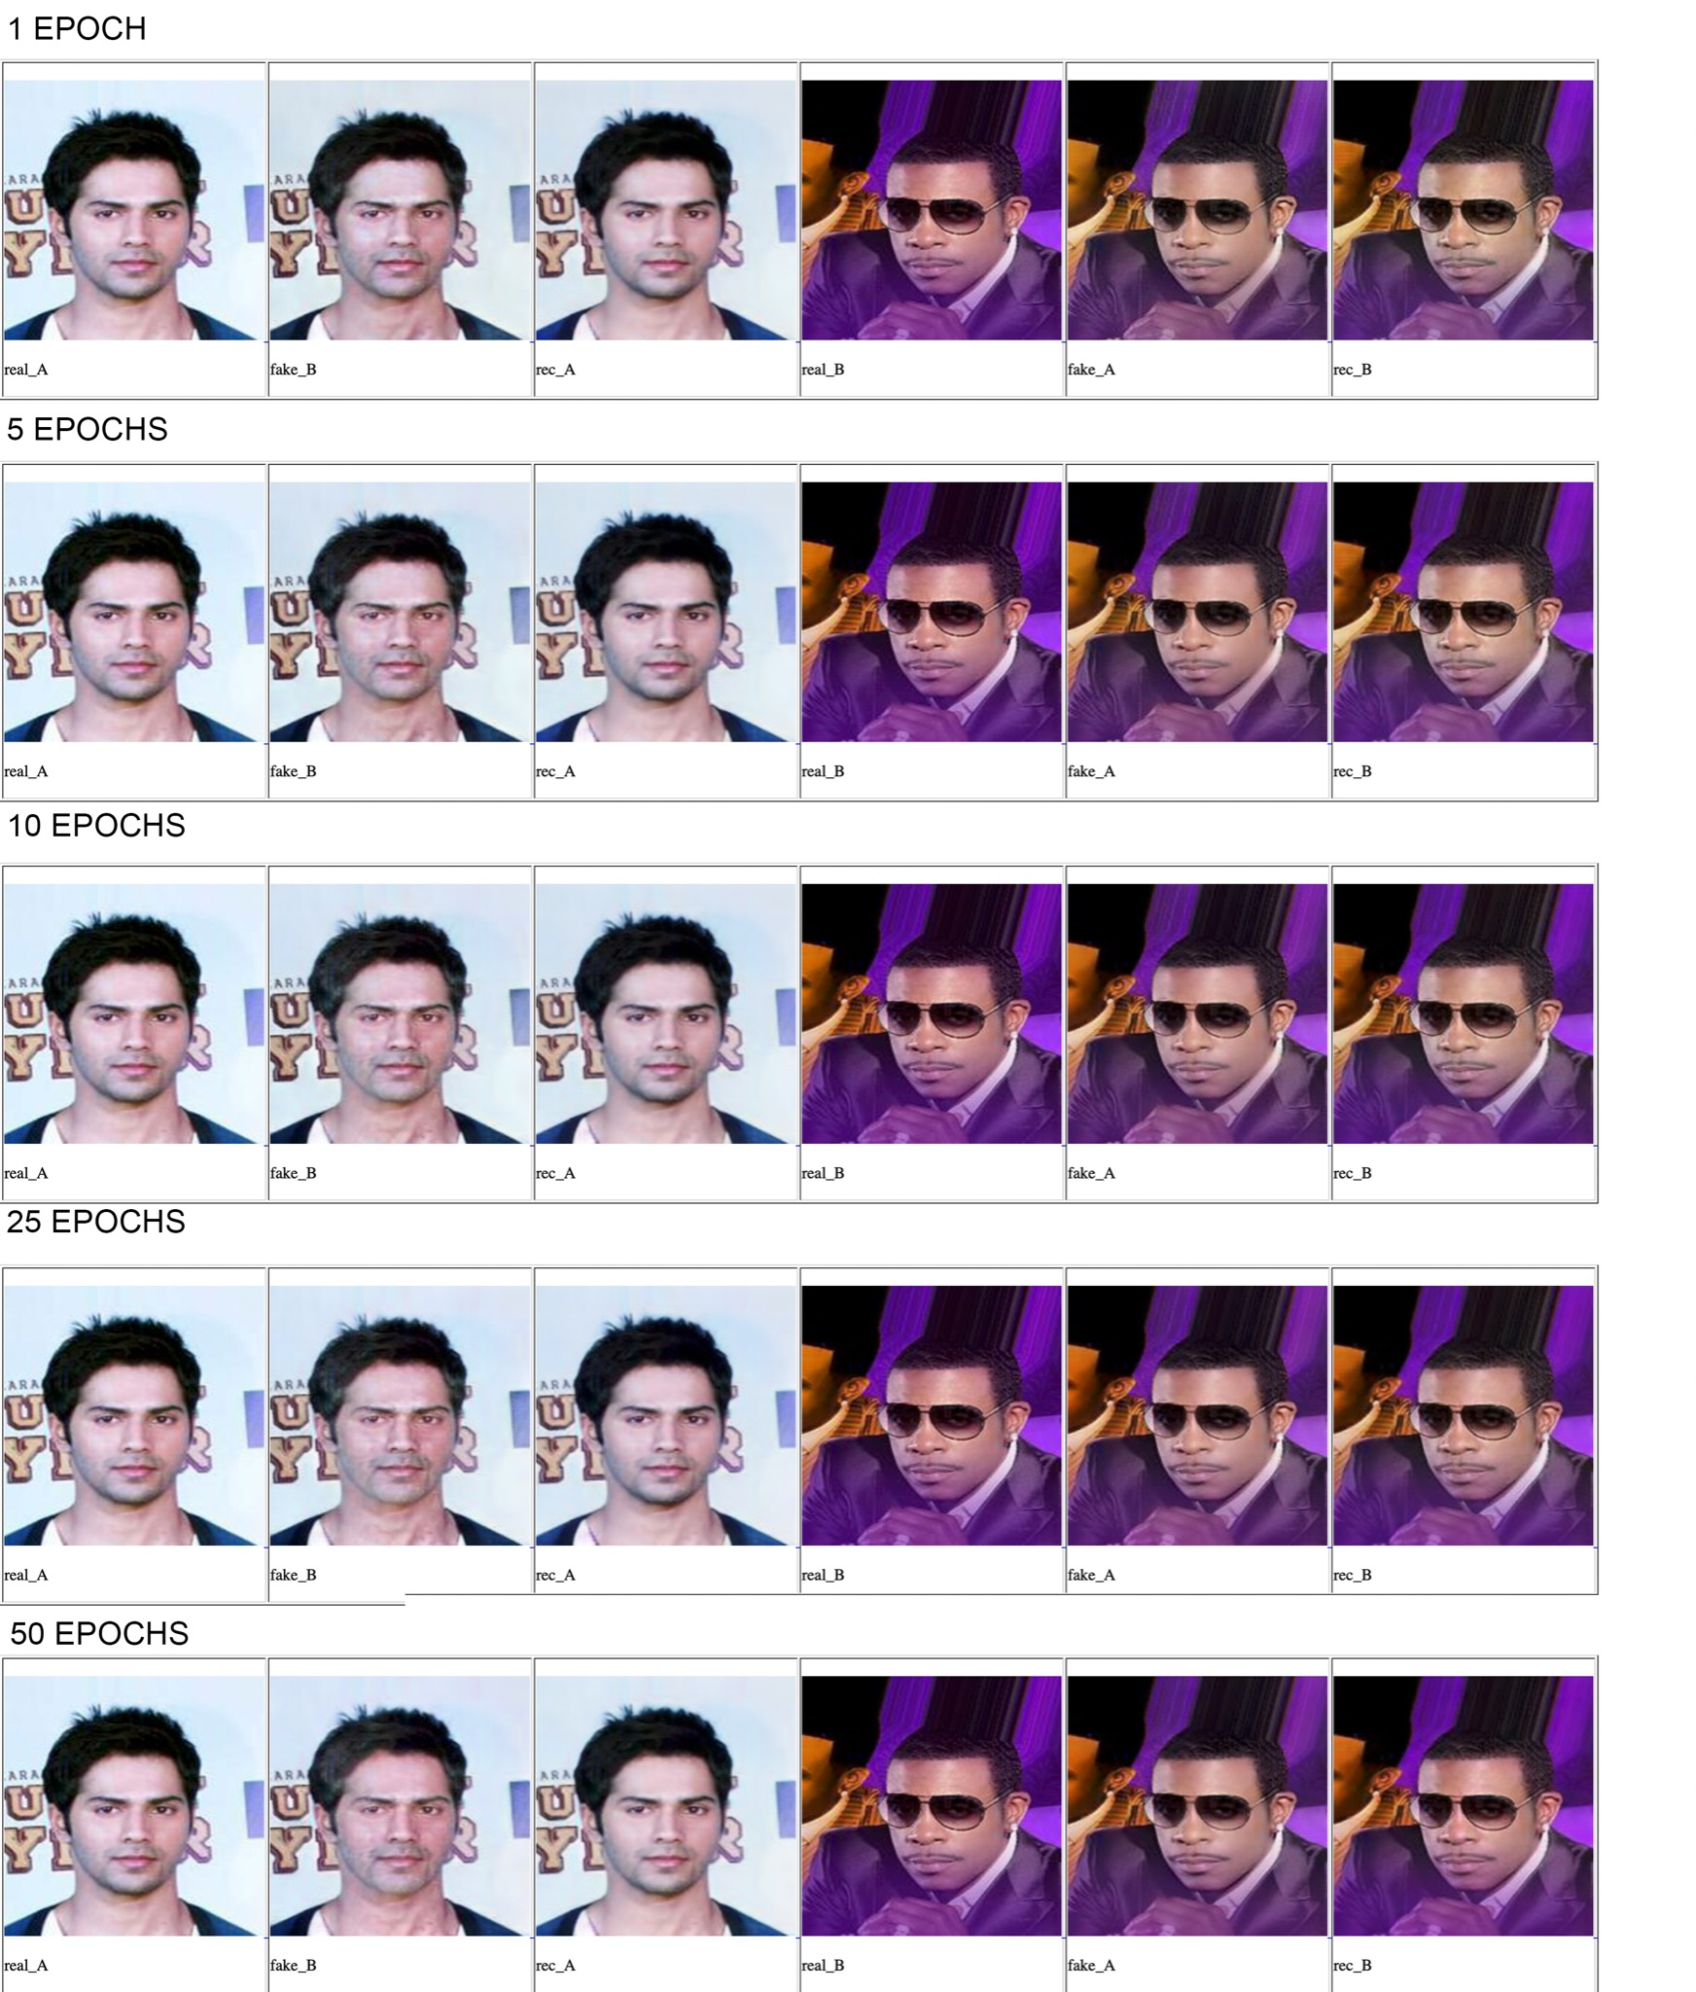
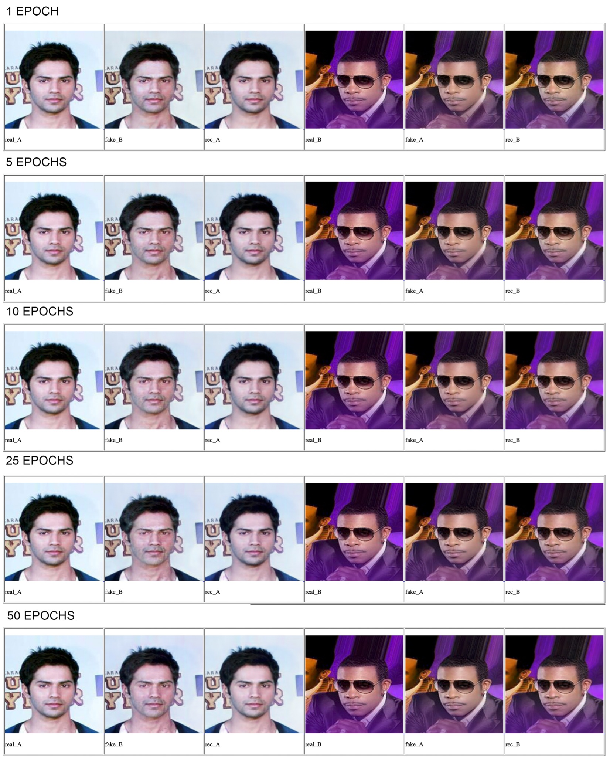
Cycle-GAN: RESULTS
Unbalanced
Balanced
Notes:
Considering that this for us is the base network, the one to beat we decide to 2 two type of experiments:
see the effect of different pre-trained model on CelebA dataset
do a little fine-tune for see if we can improve the result.
Due to the unbalanced dataset respect the young / old attribute we try to train the system with a balanced one. but the result are basically the same
We can probably obtain better result with training from scratch and with an ablation study but with fact that Cycle-GAN is slow to train we skip this, also we have to consider that is was a base network.

Slide 12
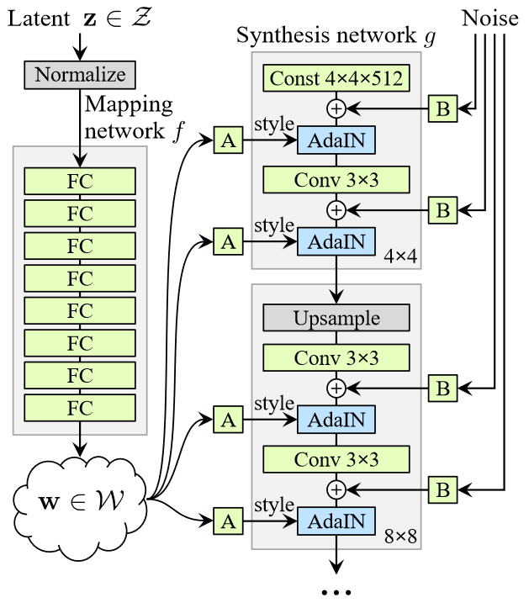
StyleGAN
Notes:
Improve generator instead of discriminator
sample latent z
FC intermediate latent w
w is style
feed style to synthesis with AdaIN
noise adds variation in output
style mixing during training for regularization
independent of resolution (final 1x1 conv)
we have 128x128 => 6 blocks => 12 AdaIN

Slide 13
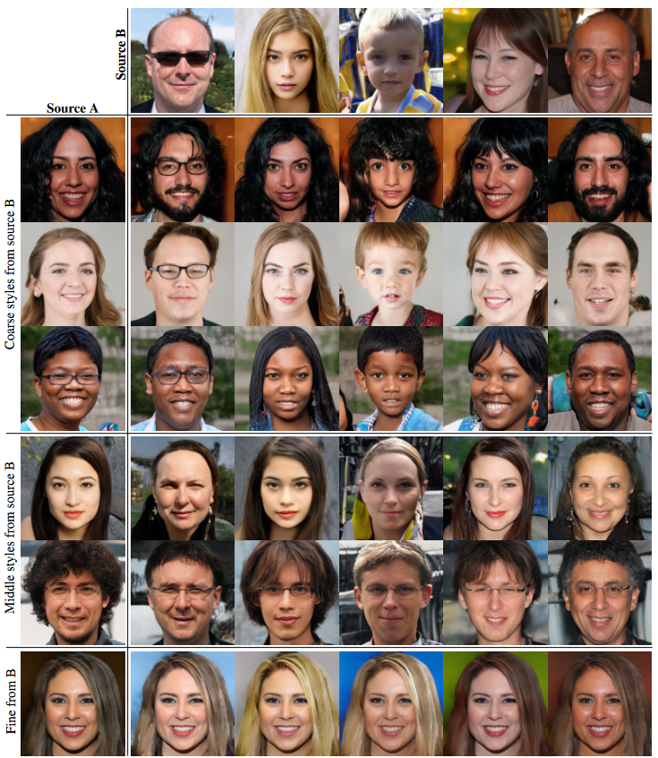
StyleGAN

Slide 14
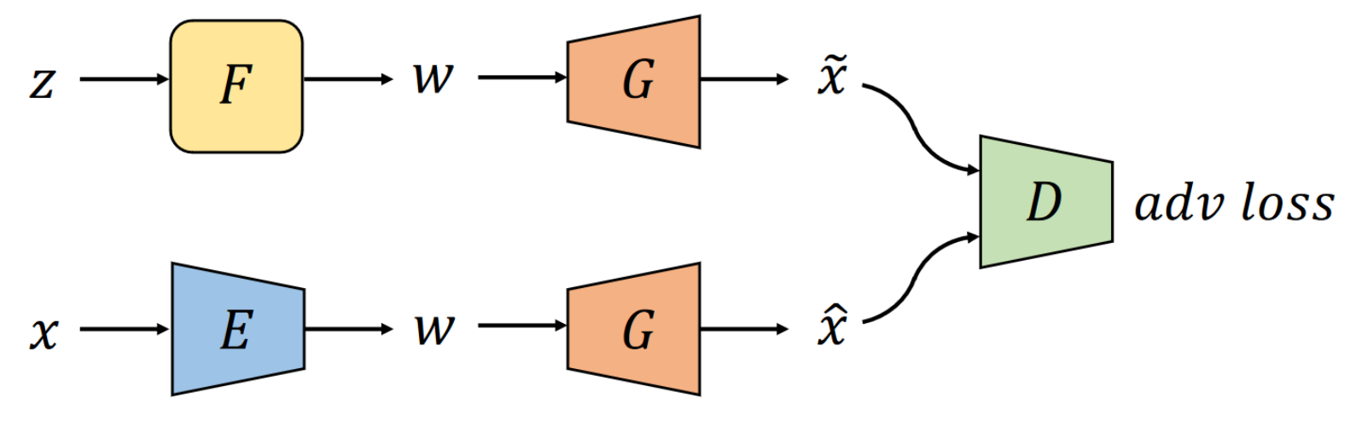
AE-StyleGAN
Train Discriminator
Train Encoder & Generator
Train Mapper & Generator
Notes:
add encoder before styleGAN
sample z, adversarial loss
encode & reconstruct, pixel loss + adversarial loss
sample z, adversarial loss
evaluate performance with FID (Fréchet Inception Distance)
similarity between distributions by overlapping volume of PDF
compute normal of images (real/ fake)
We train 75k iterations (1 week, 10k per day) vs StyleGAN train 200k

Slide 15
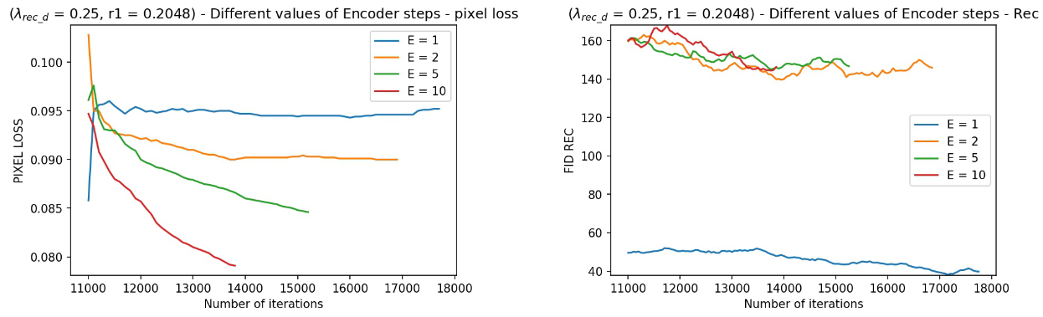
Ablation Study - Encoder Steps
Notes:
TODO: ablation or hyperparam search
TODO: encoder steps (train 2.?)
TODO: different start points

Slide 16
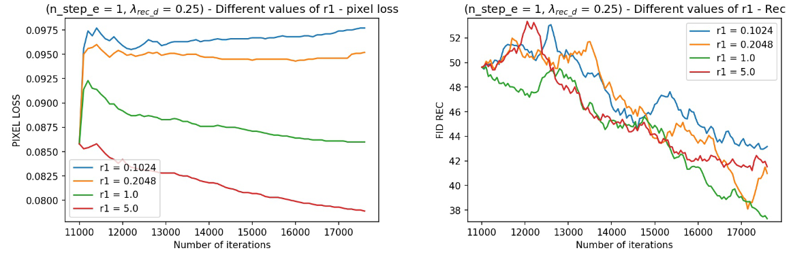
Ablation Study - R1 Regularization
Notes:
R1 loss weight
R1 regularization penalizes large gradients of discriminator when inputting real data
TODO: why best value around 0.5?

Slide 17
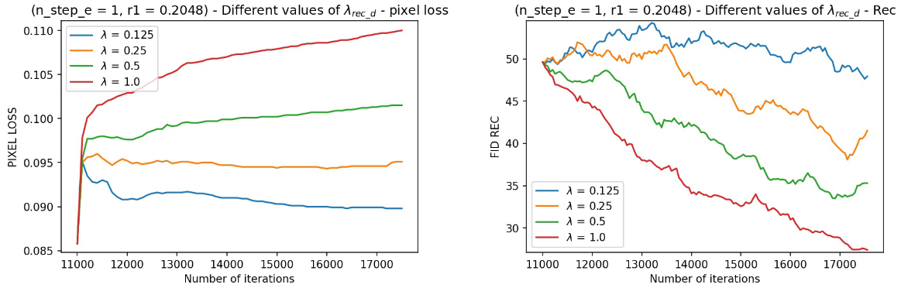
Ablation Study - Reconstruction loss
Notes:
TODO: what?
TODO: why 0.75?

Slide 18
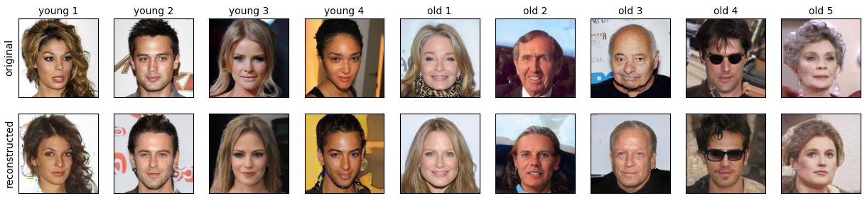
Mixing Styles

Slide 19
Mixing Styles

Slide 20
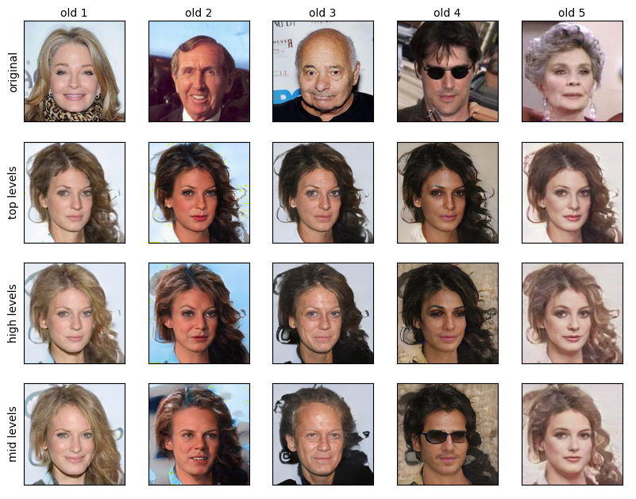
Mixing Styles
Notes:
top: 1-8, 9-12
high: 1-6, 7-12
mid: 1-4, 5-12

Slide 21
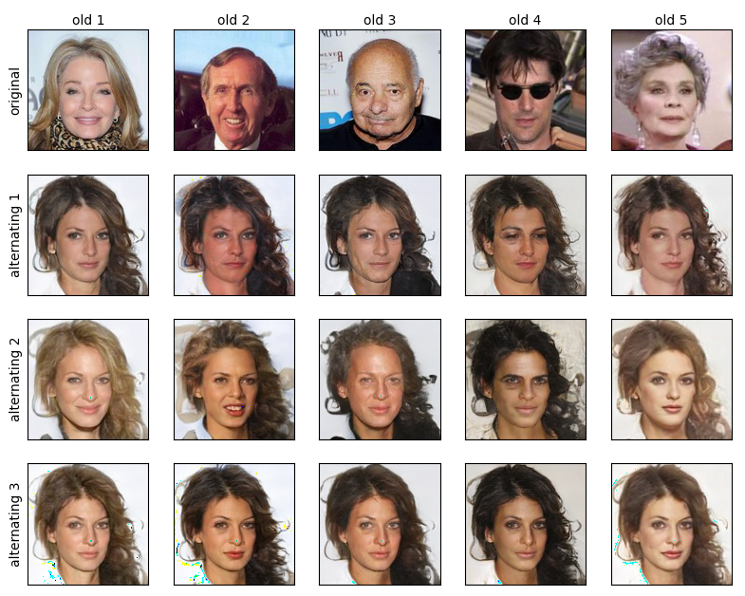
Mixing Styles
Notes:
alt 1: 6 8 10 12
alt 2: 5 7 9 11
alt 3: 9 11

Slide 22
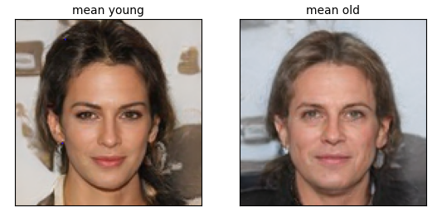
Mixing Styles
Notes:
small mean

Slide 23
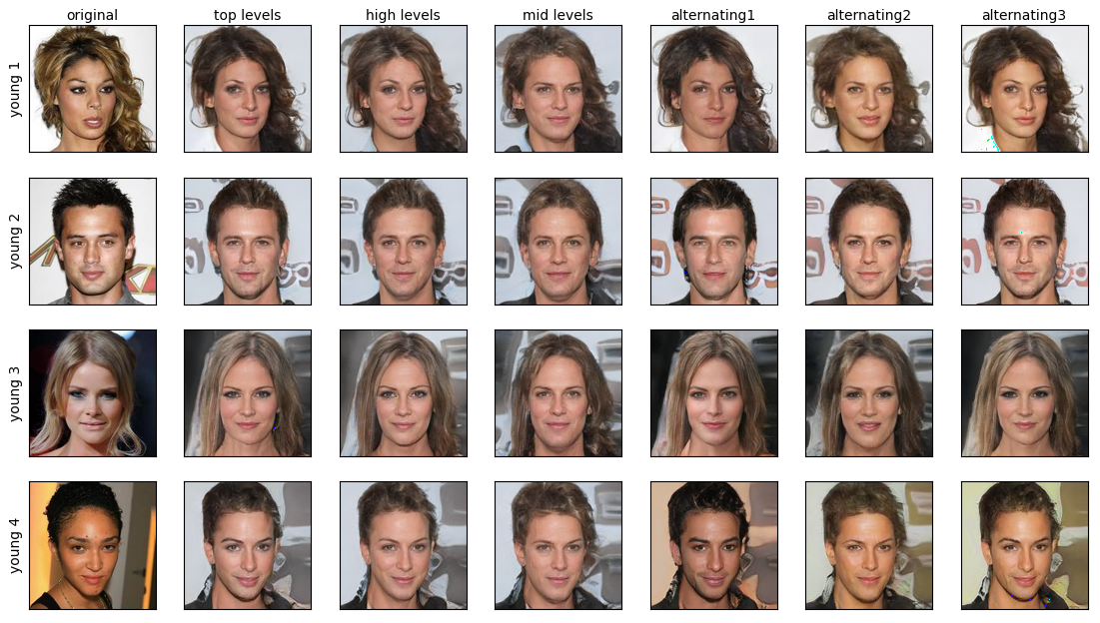
Mixing Styles

Slide 24
Mixing Styles

Slide 25
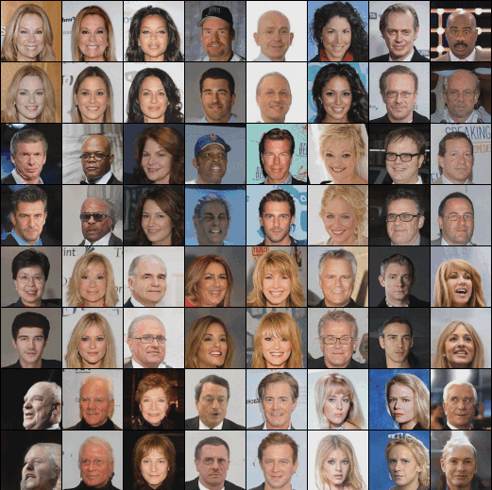
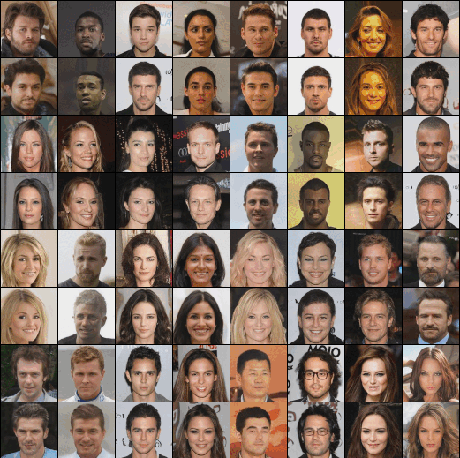
Cycle-StyleGAN
AE-StyleGAN + CycleGAN = Cycle-StyleGAN
AE-StyleGAN translates images from the source to the target domain.
Cycle consistency ensures that the translated images can be reconstructed in the original domain with minimal error.
Young-to-old filter
Old-to-young filter

Slide 26
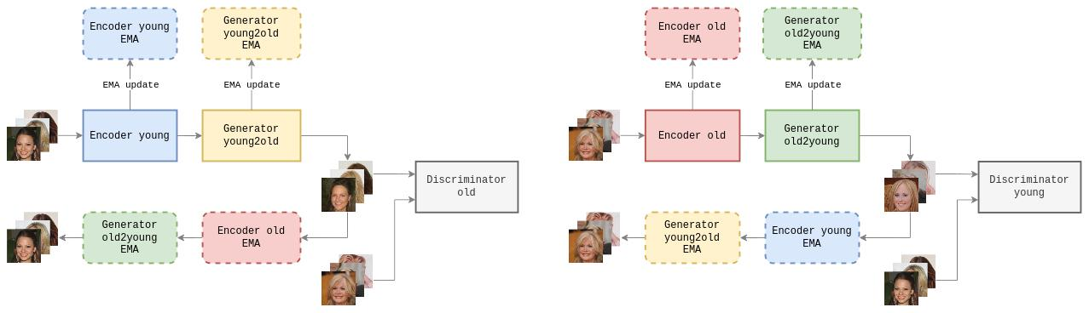
Cycle-StyleGAN: training procedure
Train discriminators using real young and old images.
Train encoder and generator of the first filter:
Translate the young images in the old domain and compute the discriminator loss.
Project back the images in the original domain and compute the pixel loss between the original and reconstructed images.
Repeat the process for the the second filter.
Young-to-old filter
Old-to-young filter

Slide 27
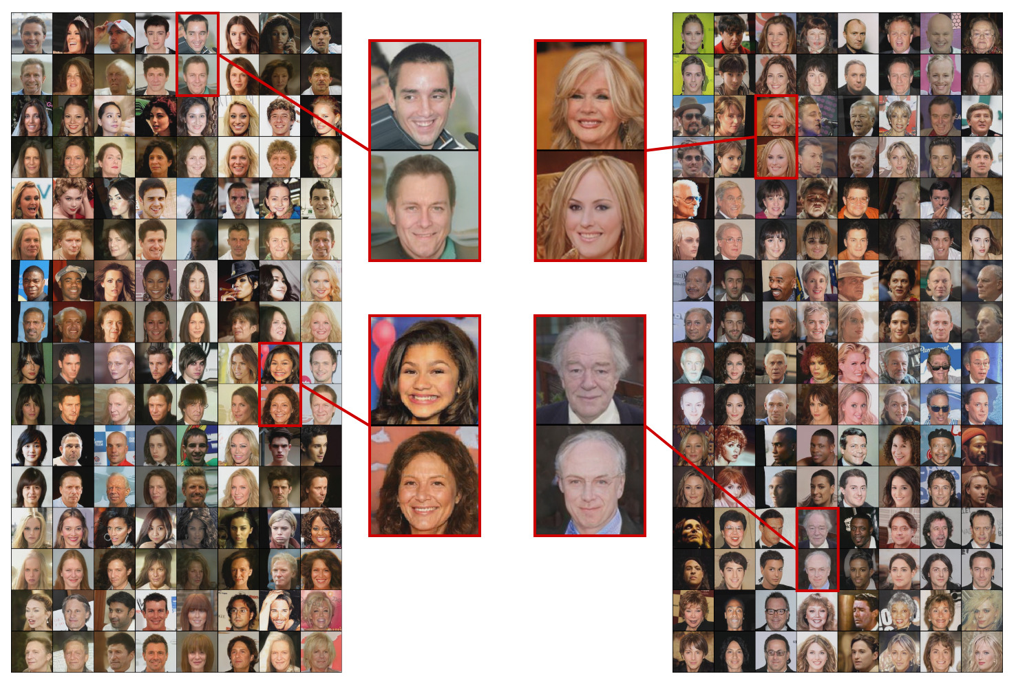
Cycle-StyleGAN: results
Young-to-old filter
Old-to-young filter

Slide 28
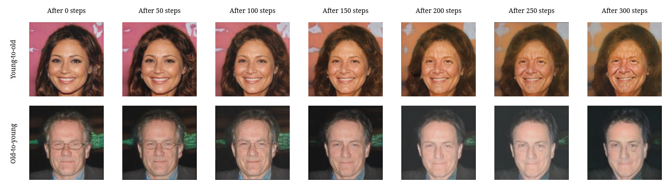
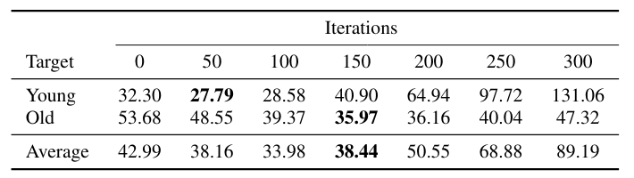
Cycle-StyleGAN: results (2)
Progression of Cycle-StyleGAN results versus increasing number of iteration
The best FID is reached after 150 iterations. Afterwards, the network performance starts to degrade.

Slide 29
Conclusions and future work
Cycle-StyleGAN outperforms CycleGAN and produces convincing results…
BUT
There are several open issues:
Cycle-StyleGAN performance suffer from longer training
CelebA is probably not the best dataset for face filter development due to low quality images and high correlation between attributes.
The usage of segmentation masks could prevent the network from modifying the background of the images.

Slide 30
The Take-Home message

